Slide 1




if you
[always run late]
this is
for you
Everything blue is a guide. Delete it before you download.
Notes:
Slide 1. Hook. Swap in a photo of you (head near the top, under the butterfly). Edit the [bracket] line to your buyer's habit.

Slide 2




[always running
late?]
[here's what helps]
Notes:
Slide 2. Second hook: Instagram often shows a carousel starting on slide 2, so this one works as a cover on its own. No photo needed. Edit both [bracket] lines.

Slide 3


[you lose your
keys. again.]
Photo: click it, then Replace. Filters > B&W
Notes:
Slide 3. Swap in a photo of the everyday problem. Tip: set it to black and white (Edit photo > Filters).

Slide 4



meet
[PRODUCT NAME]
Notes:
Slide 4. Swap in your product photo and type its name.

Slide 5



[what it fixes,
in one line]
Notes:
Slide 5. A second product photo (or the same one). Edit the line to what it fixes, in your words.

Slide 6




for the
[6am crowd]
for the
[dog mums]
for the
[busy mums]
Notes:
Slide 6. Who it's for: three kinds of buyer, one per note.

Slide 7

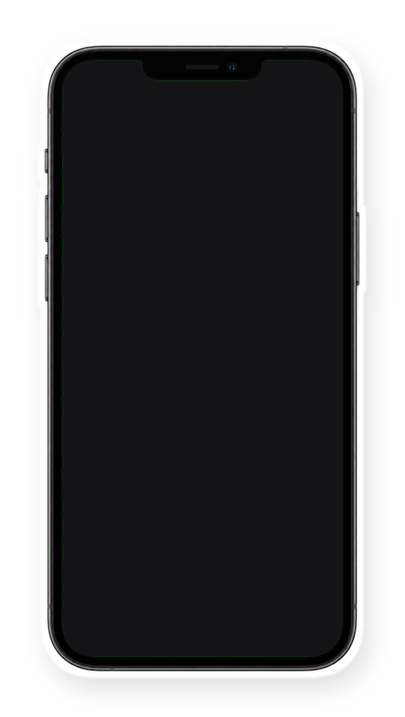

[in my shop now]
Notes:
Slide 7. Swap in a screenshot of your shop or listing for the phone screen. Edit the line.

Slide 8




sound like you?
Comment
"[KEYWORD]"
Notes:
Slide 8. Swap in a second photo of you (head near the top, under the crown). Type your keyword. Caption to start from (CTA in the first two sentences, 3 hashtags): Comment [KEYWORD] and I will send you [the link]. [One line of real context: who it helps or how you use it.] #[tag] #[tag] #[tag]

